Slide 1

Capstone 3 Machine Learning
BANK CAMPAIGN
MARKETING
BUSINESS PRESENTATION
Helvila
DTI- DS
July 2024

Slide 2

OBJECTIVE
The banking industry is currently undergoing a significant transformation driven by technological advancements, regulatory changes, and evolving consumer preferences. Digital transformation is at the forefront, with traditional banks adopting fintech solutions to enhance their digital services.

Slide 3

PROBLEMS
01
Inefficiencies Campaign
Currently, the bank's marketing campaigns involve contacting all potential customers without any filtering, leading to inefficiencies in terms of time and cost. This approach results in many unsuccessful contacts, as a significant portion of the customers contacted do not end up subscribing to the term deposit.
02
Target
We will use precision as our primary evaluation metric.

Slide 4
THE DATA
Number of Contacts During Campaign:
Previous Campaign Outcome:
Age Distribution
The majority of customers are between 30 and 50 years old, with a peak around 35-40 years.
Most customers were contacted 1 to 3 times, with a sharp decline in the number of customers contacted more than 10 times.
The majority of previous campaign outcomes are either 'unknown' or 'failure', with very few 'success' outcomes.

Slide 5
EXPERIMENT DESIGN
First
Focus on basic setup
data split
Second:
Benchmark model
Third:
Tuning model

Slide 6

THE BEST PERFORMENTS MODEL
Model | before | after tuning
Gradient Boost Classifier | 0.779 | 0.766
Xgboost | 0.743 | 0.79

Slide 7
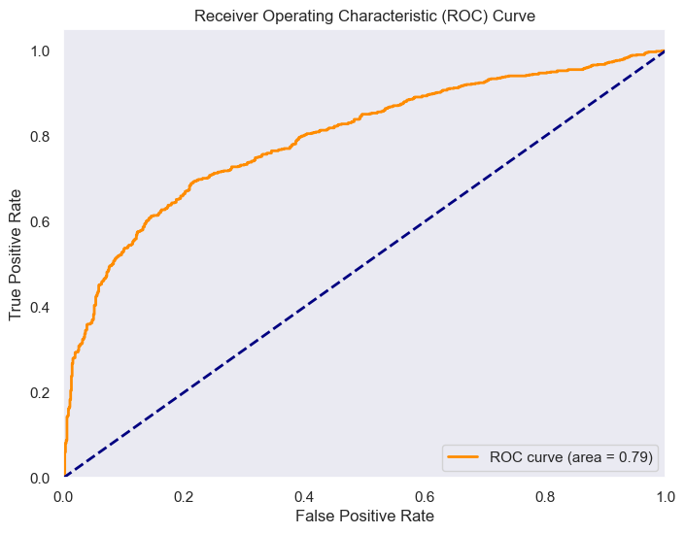

MODEL EVALUATION
In summary, the ROC curve and AUC score indicate that the XGBoosting Classifier, after hyperparameter tuning, has a good ability to differentiate between customers who are likely to deposit and those who are not. The model is effective but still has room for improvement to achieve even higher discrimination power.

Slide 8
EVALUATION MATRIX
 | tuning | before
accuracy | 74% | 73%
precision | 79% | 78%
recall | 61% | 62%
After tuning the XGBoost Classifier, the precision improved to 0.786, indicating that 78.6% of the positive predictions are correct. The overall accuracy increased slightly to 0.74. The recall for class 1 (term deposit) is 0.61, meaning the model correctly identifies 61% of the actual positive cases. The f1-score for class 1 is 0.69, showing a balanced performance between precision and recall.

Slide 9
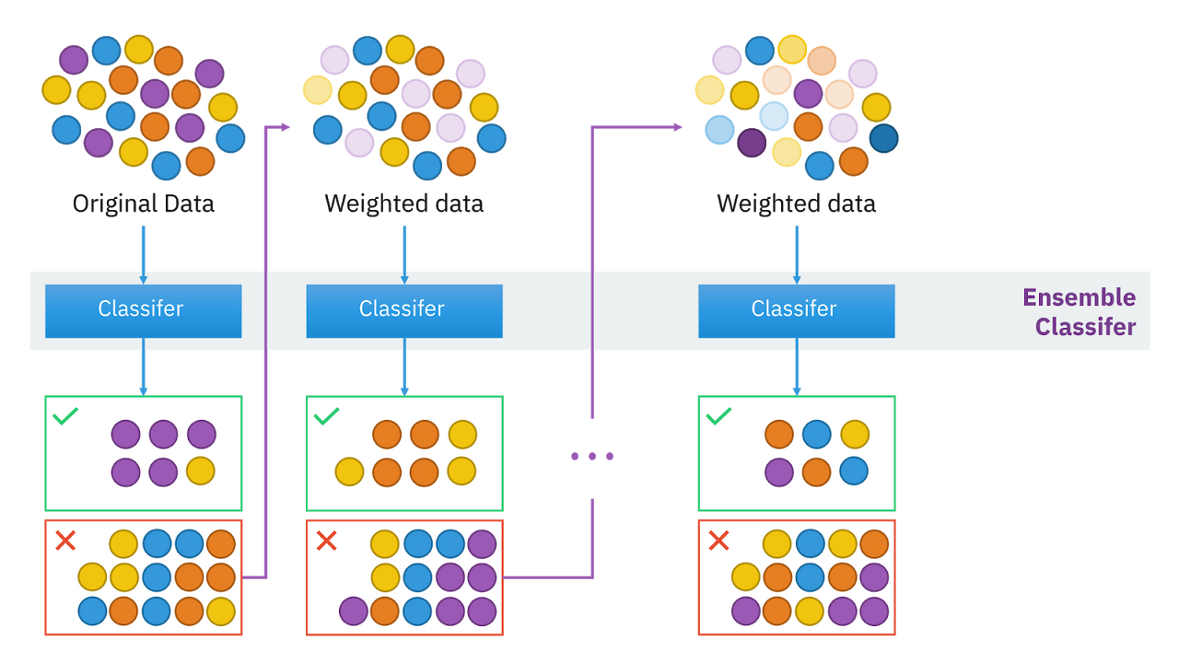
XGBOOST
XGBoost (Extreme Gradient Boosting) is a machine learning algorithm that's used for supervised learning problems, where we want to predict a target variable based on a set of input features. It's particularly known for its speed and performance.
Credit: Intuition behind the boosting algorithm, Author: Sirakorn Lamyai

Slide 10
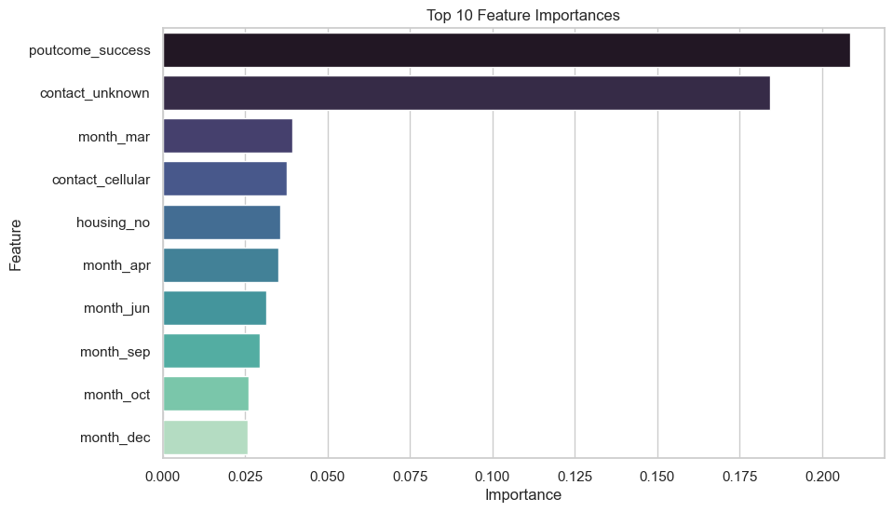
FEATURE IMPORTANCE
The feature importance plot from the XGBoost classifier indicates that the most influential features for predicting whether a client will make a deposit are the success of previous marketing campaigns(poutcome_success), unknown contact type (other than cellular and telephone), and contacts made in March (month_mar).

Slide 11
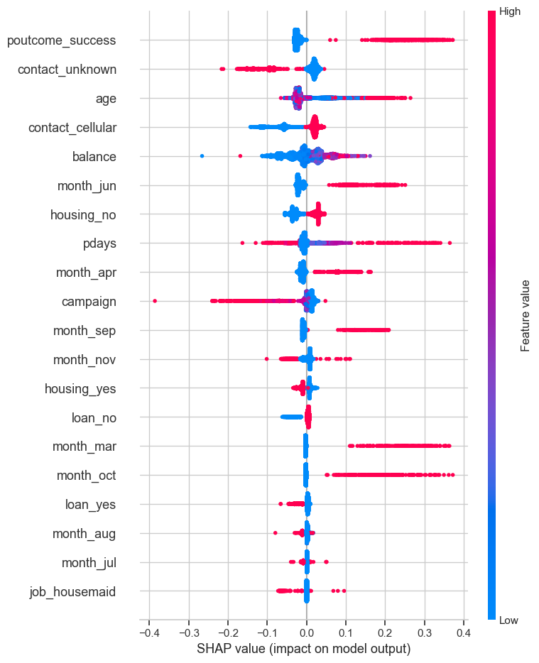
SHAP
The SHAP summary plot shows which features have the most influence on the model's predictions. Each dot represents a feature's impact on a single prediction. The colors show feature values (red for high, blue for low). For instance, if poutcome_success is high (red), it strongly increases the chance of a positive outcome (term deposit subscription). In contrast, if housing_yes is high, it lowers the chance of a positive outcome. This helps us see which features are most important and how they affect the model's decisions.

Slide 12
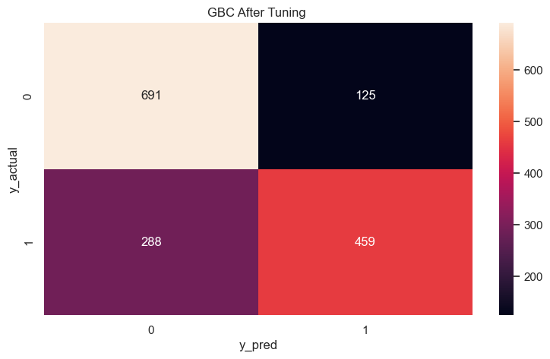
IMPACT
Total Contact Cost Before Using Machine Learning
Assume:
Total Contacts: 7813
Contact Distribution:
Cellular: 72% of 7813
Unknown (Email, etc.): 21% of 7813
Telephone: 7% of 7813
Contact Costs:
Cellular: 5624×$1=$5624
Unknown: 1641×$2=$3282
Telephone: 547×$0.10=$54.70
Total Cost Before Using Machine Learning:
$5624+$3282+$54.70=$8960.70
Total Contact Cost Using Machine Learning
TP + FP: 459 + 125 = 584
Contact Costs After Model:
Cellular: 421×$1=$421
Unknown: 123×$2=$246
Telephone: 41×$0.10=$4.10
Total cost $670
Cost Savings
$8960.70−$671.10=$8289.60

Slide 13
CONCLUSION
RECOMMENDATION
This project aimed to develop a machine learning model to
predict if customer will subscribe on term deposit in bank. the model has demonstrated (precision: 0.79) its ability to predict customer behavior regarding bank deposit subscriptions effectively. This is evidenced by its significant role in enhancing the bank's ability to identify potential customers who are likely to subscribe, thus directly addressing the business problem of improving conversion rates in deposit subscriptions.
Bank Marketing Team
Prioritize cellular contacts, which although more costly than telephone, are less expensive than unknown methods and have shown a strong influence on the customer’s decision to subscribe, as reflected in feature importance rankings.
Leverage insights from the model to tailor communications specifically to segments identified as more likely to convert.

Slide 14
THANK YOU
FOR YOUR NICE ATTENTION
July 2024

